Slide 1
Chapter Eight
Products, Services, and Brands: Building Customer Value

Slide 2
Product, Services, and Branding Strategy
Topic Outline
What Is a Product?
Product and Services Decisions
Branding Strategy: Building Strong Brands
Services Marketing

Slide 3

What Is a Product?
Products, Services, and Experiences
Product is anything that can be offered in a market for attention, acquisition, use, or consumption that might satisfy a need or want
Service is a form of product that consists of activities, benefits, or satisfaction offered for sale and are essentially intangible and don’t result in the ownership of anything.
Experiences represent what buying the product or service will do for the customer
Notes:
Note to Instructor
This Web link is a great example of a store that creates experiences is Jordan’s Furniture in the Boston. These furniture stores include an Imax theater, an amusement park quality motion ride, a trapeze school, and Mardi Gras parades. You can visit their stores through their Web sites.

Slide 4
Product is a key element in the overall market offering. Marketing mix planning begins with formulating the offering that brings value to target customers. This offering becomes the basis upon which the company builds profitable relationship with customers.
A company’s market offering often includes both tangible goods and services. The offer may consist of a pure tangible good, at the other extreme are pure service. Between these 2 extremes, many goods and services combinations are possible.

Slide 5
What Is a Product?
Organizations, Persons, Places, and Ideas
In addition to tangible products and services, marketers have broadened the concept of a product to include other market offerings; organizations, persons, places and ideas.
Organization marketing consists of activities undertaken to create, maintain, or change attitudes and behavior of target consumers toward an organization.Business firms sponsor public relations or corporate image advertizing campaigns to polish their images and market themselves.

Slide 6
What Is a Product?
Organizations, Persons, Places, and Ideas
Person marketing consists of activities undertaken to create, maintain, or change attitudes and behavior of target consumers toward particular people. sometimes used to build reputation.
Notes:
Note to Instructor
The text highlights Rachael Ray who has become a one-woman marketing phenomenon.
In less than a decade, she’s zipped from nobody to pop-culture icon. Beginning with her 30-Minute Meals cookbooks, followed later by a Food Network TV show.
Bearing her name are more than a dozen best-selling cookbooks (the latest is Yum-o! The Family Cookbook), a monthly lifestyle magazine, three Food Network shows, a syndicated daytime talk show, and assorted licensing deals that have stamped her name on kitchen essentials from knives to her own “E.V.O.O.” (extra virgin olive oil for those not familiar with Rayisms).
There are even Ray-branded music CDs and ring tones.
Her brands “begin with food and move briskly on to the emotional, social, and cultural benefits that food gives us.” Ray’s persona—and hence her brand—is a “celebration of why food matters.”

Slide 7
What Is a Product
Organizations, Persons, Places, and Ideas
Place marketing consists of activities undertaken to create, maintain, or change attitudes and behavior of target consumers toward particular places or destinations.
Ideas can also be marketed.
Notes:
Note to Instructor
Las Vegas has worked hard to bring themselves into the forefront as a major destination for business and leisure. This YouTube ad is from their famous “What happens in Vegas, stays in Vegas” campaign.

Slide 8
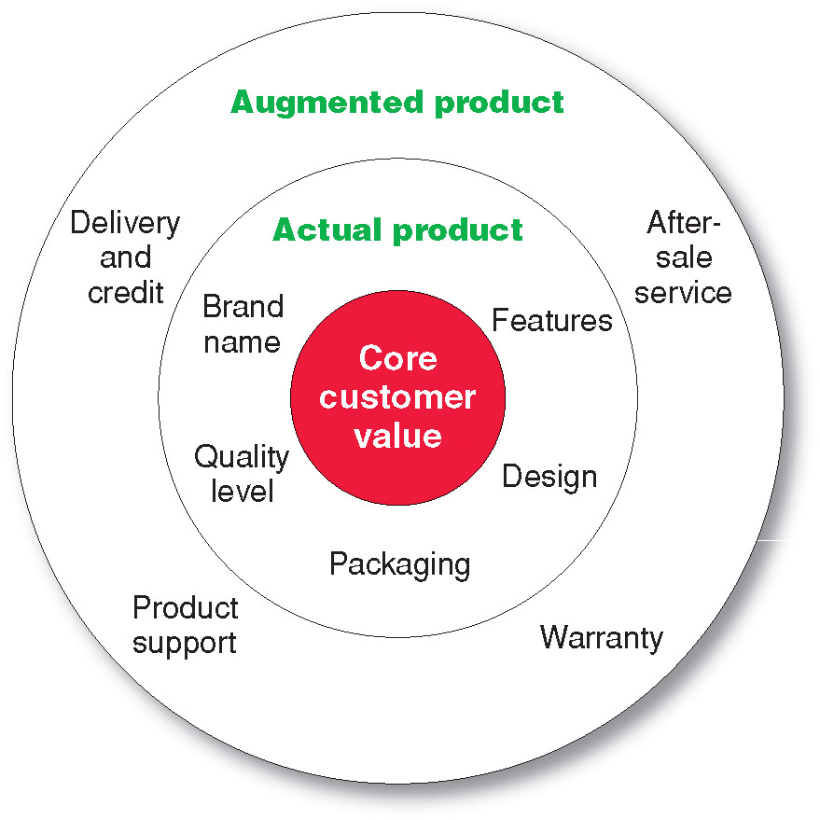
What Is a Product?
Levels of Product and Services
Notes:
Note to Instructor
Core benefits represent what the buyer is really buying.
Actual product represents the design, brand name, and packaging that delivers the core benefit to the customer.
Augmented product represents additional services or benefits of the actual product.
It is a good idea for the students to bring in some products so the class can discuss the levels of product and services. Products including Gatorade, toothpaste, facial moisturizer or cosmetics work well in this discussion. You can often find augmented product features on the product’s Web sites including games, features and support.

Slide 9
Consumers see products as complex bundles of benefits that satisfy their needs.

Slide 10
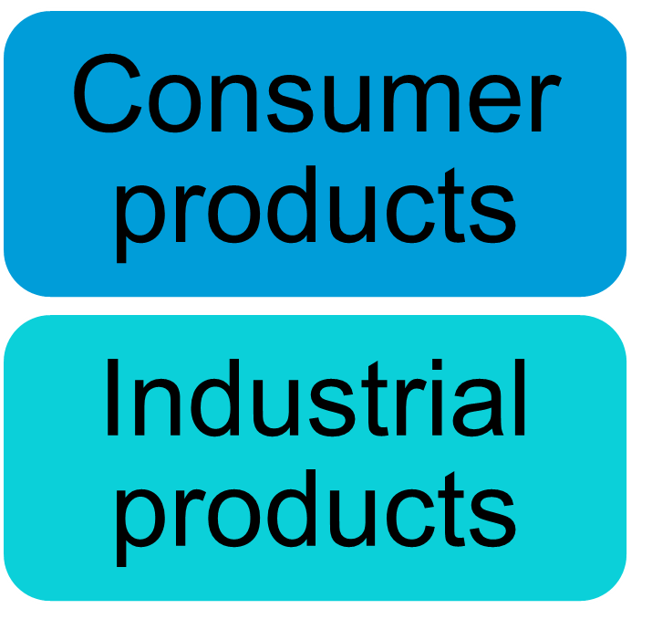

What Is a Product?
Product and Service Classifications

Slide 11
What Is a Product?
Product and Service Classifications
Consumer products are products and services bought by final consumers for personal consumption
Classified by how consumers buy them
  Convenience products
  Shopping products
  Specialty products
  Unsought products

Slide 12
What Is a Product?
Product and Service Classifications
Convenience products are consumer products and services that the customer usually buys frequently, immediately, and with a minimum comparison and buying effort
Newspapers
Candy
Bread

Slide 13
What Is a Product?
Product and Service Classifications
Shopping products are consumer products and services that the customer compares carefully on suitability, quality, price, and style
Furniture
Appliances

Slide 14
What Is a Product?
Product and Service Classifications
Specialty products are consumer products and services with unique characteristics or brand identification for which a significant group of buyers is willing to make a special purchase effort
Medical services
Car
High-end electronics

Slide 15
What Is a Product?
Product and Service Classifications
Unsought products are consumer products that the consumer does not know about or knows about but does not normally think of buying
Life insurance
Blood donations
Telemall
Notes:
Note to Instructor
Discussion Question
What is a product that could be convenience, shopping, and specialty?
This is a bit of a puzzle. They might realize that a camera could fall into several categories depending on the buyer and the situation. Certainly, if you are on vacation and you forgot your camera, you would pick one up at a convenience store, pharmacy, or maybe the hotel store. If you were a professional photographer, a camera purchase could easily be specialty if you were buying a $5,000 camera. Other examples might include mats for the floor of a automobile, tires, or a fan.

Slide 16
What Is a Product?
Product and Service Classifications
Industrial products are products purchased for further processing or for use in conducting a business
Classified by the purpose for which the product is purchased
  Supplies and Services.
  Capital items.
  Raw materials.

Slide 17

What Is a Product?
Product and Service Classifications
Capital items are industrial products that aid in the buyer’s production or operations
Materials and parts include raw materials and manufactured materials and parts usually sold directly to industrial users
Supplies and services include operating supplies, repair and maintenance items, and business services
Notes:
Note to Instructor
This Web link brings you to CBIZ—a consulting firm for businesses. It is interesting to look at their drop-down menus for an overview of the services they offer.

Slide 18
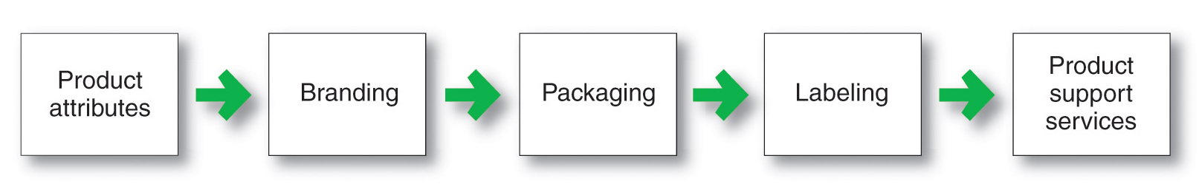
Product and Service Decisions
Marketers make product and service decisions at three levels:
Individual product decisions
Product line decisions
Product Mix decisions
I-Individual Product and Service Decisions

Slide 19

Product and Service Decisions
Individual Product and Service Decisions
Product attributes are the benefits of the product or service
Quality
Features
Style and design
Notes:
Note to Instructor
In slideshow view, click on movie icon to launch Swiss Army video snippet. See accompanying DVD for full video segment

Slide 20
Quality
Quality is when our customer come back and our products don’t.
Return on quality
Total quality Management TQM
Conformance quality
Freedom from defects

Slide 21
Features
Competitive tools for differentiation
Should be judged on value to cost ratio

Slide 22
Style &
Design
Difference B/W Style and Design?

Slide 23
Product and Service Decisions
Individual Product and Service Decisions
Brand is the name, term, sign, or design—or a combination of these—that identifies the maker or seller of a product or service
Brand equity is the differential effect that the brand name has on customer response to the product and its marketing
Notes:
Note to Instructor
Discussion Questions
What brands do you tend to purchase consistently? Why?
This discussion should lead to the consumer benefits of brands including quality and consistency. It is interesting to now ask students what the benefits might be for the seller of having a strong brand. This will include segmentation, positioning, and the ability to communicate product features

Slide 24
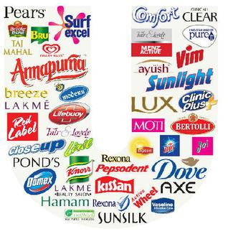

Slide 25
Branding help Buyers in many ways:
  Identify products that might benefit them.
  Brands say something about product quality and consistency
Branding help sellers in many ways:
  Legal protection for unique product features.
  Basis upon which the product’s special qualities are built .
  Help in segmenting markets.
  Building and managing brands are one of the most important tasks of a marketer.

Slide 26
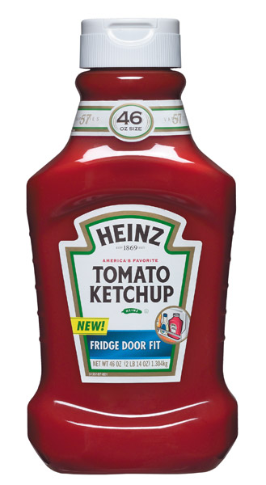
Product and Service Decisions
Individual Product and Service Decisions
Packaging involves designing and producing the container or wrapper for a product.
Packages nowadays attract attention,describe the product and make the sale.
Labels identify the product or brand, describe attributes, and provide promotion.
Labels have been affected by unit pricing, open dating and nutritional labeling.
Notes:
Note to Instructor
Warning: This is a very GRAPHIC link to the Government of Brazil’s notice of labeling for cigarettes. Although the release is in Spanish, the images for the labeling is given on the right hand side.

Slide 27
Product and Service Decisions
Individual Product and Service Decisions
Product support services augment actual products
Survey customers periodically
Assess costs
Develop a package of services that will delight customers and yield profit.
Sophisticated mix of interactive technologies to provide support services.
Notes:
Note to Instructor
Companies must continually:
Assess the value of current services to obtain ideas for new ones.
Assess the costs of providing these services.
Develop a package of services to satisfy customers and provide profit to the company.

Slide 28
Product and Service Decisions
II- Product Line Decisions
Product line is a group of products that are closely related because they function in a similar manner, are sold to the same customer groups, are marketed through the same types of outlets, or fall within given price ranges

Slide 29



Product Mix Decisions
Width - number of different product lines
Length - total number of items
within the lines
Product Mix -
all the product
lines offered
Consistency
Depth - number of versions of each product
Notes:
Product Mix Decisions
This CTR relates to the material on pp. 257-258.
Product Mix Decisions
Mix Width. This refers to how many product lines the company carries.
Mix Length. This refers to the total number of products the company carries.
Mix Depth. This refers to how many versions are offered of each product in the line.
Mix Consistency. This refers to how closely related the various product lines are in end use, production requirements, distribution channels, or other ways.

Slide 30

Product Line Decisions
Product Line Length
Number of Items in the Product Line
Stretching
Lengthen beyond current range
Filling
Lengthen within current range
Downward
Upward
Notes:
Product Line Decisions
Product Line Length. This refers to the number of products in the line. The line is too short if adding items increases profits; too long if dropping items increases profits. Company objectives of full-line offerings may decrease strict profit criterion on length.
Product Line Stretching. This occurs when a company lengths is product line beyond its current range. Downward stretch offers items to lower end of the market. Upward stretch introduces items to high end of market. Two-way stretch extends the line both upward and downward.
Product Line Filling. This adds items within the existing product range of the line.
Product Line Decisions
This CTR relates to the material on pp. 255-257.

Slide 31
Product and Service Decisions
Product Line Decisions
Product line length is the number of items in the product line
Line stretching ( beyond its current range,downward, upward or both directions)
Line filling (adding more items within the present range of the line) reasons are:
extra profits
satisfying dealers
using excess capacity
plugging holes to keep out competitors
being the leading full line company.
  Extra profits
Notes:
Note to Instructor
Product line stretching is when a company lengthens its product line beyond its current range.
Downward product line stretching is used by companies at the upper end of the market to plug a market hole or respond to a competitor’s attack.
Upward product line stretching is by companies at the lower end of the market to add prestige to their current products.
Combination line stretching is used by companies in the middle range of the market to achieve both goals of upward and downward line stretching.
Product line filling occurs when companies add more items within the present range of the line.

Slide 32
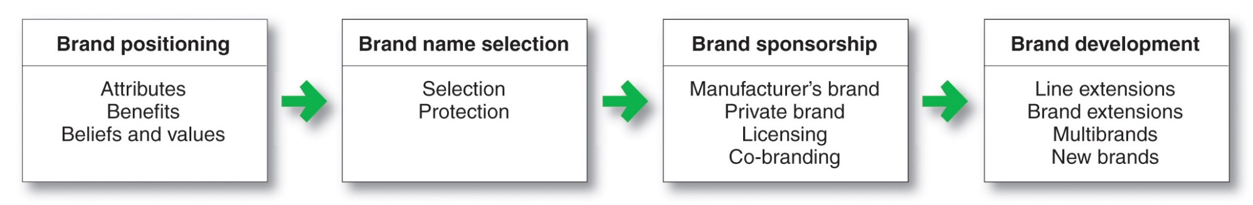
Branding Strategy: Building Strong Brands
Brand represents the consumer’s perceptions and feelings about a product and its performance. It is the company’s promise to deliver a specific set of features, benefits, services, and experiences consistently to the buyers
1- Brand equity: the positive differential effect that knowing the brand name has on customer response to the product or service.

Slide 33
High brand equity provides a company with many competitive advantages:
  High level of consumer brand awareness and loyalty.
  More leverage in bargaining with resellers
  High credibility
  The company can easily launch line and brand extensions.
  Defence against fierce competition
  Basis for building strong and profitable customer relationships.

Slide 34






Major Brand Decisions
Brand Name Selection
Selection
Protection
Brand Sponsor
Manufacturer’s Brand
Private Brand
Licensed Brand
Co-branding
Brand Strategy
Line Extensions
Brand Extensions
Multibrands
New Brands
Notes:
Major Branding Decisions
This CTR corresponds to Figure 8-3 on p. 247 and relates to the material on pp. 247-252.
Major Branding Decisions
Brand Decision. At this stage, the company must decide whether or not to place a brand name on its product. Brands usually command higher profit margins than non-brands.
Brand Name Selection. Desirable qualities for a brand name include:
1. It should suggest something about the product’s benefits.
2. It should be easy to pronounce and remember.
3. It should be distinctive.
4. It should translate easily into foreign languages.
5. It should be eligible for registration and legal protection.
Brand Sponsor. Who sponsors the brand must also be decided. Manufacturer's or National brands are owned by the producer. Private brands are created and owned by a reseller. Mixed-brand strategies combine both approaches.
Brand Strategy. This decision area consists of at least four choices, covered in greater detail on the following CTR.

Slide 35
Brand Name Selection
Good Brand Names:
  Suggest something about the product or its benefits (Fair and handsome)
  Are easy to say, recognize and remember (ipod, Geo, bonjour)
  Are distinctive (Fri-chicks, Fried chicks)
  Are easily extendable(amazon.com)(Servis)
  Translate well into other languages (Geo, sooper)
  Can be registered and legally protected

Slide 36
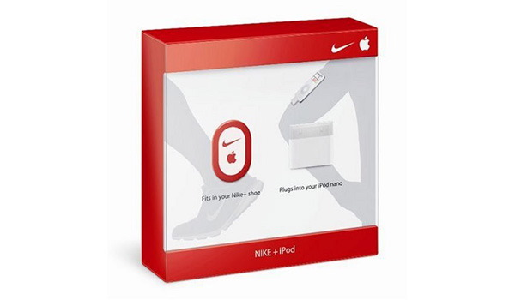
Brand Sponsorship
Manufacturer / National brands
  Producers own brand e.g Sony, Apple
Private (store) brands
  Reseller/whole seller brand e.g Metro, HKB, George
Licensed brands
  Give rights to use IP (intellectual property) MS office, Pepsi cola
Co-branding
  Two established brand put hand in hand to market a single product
  Giving away your brand is a lot like giving away your child -- you want to make sure every thing is perfect..”

Slide 37
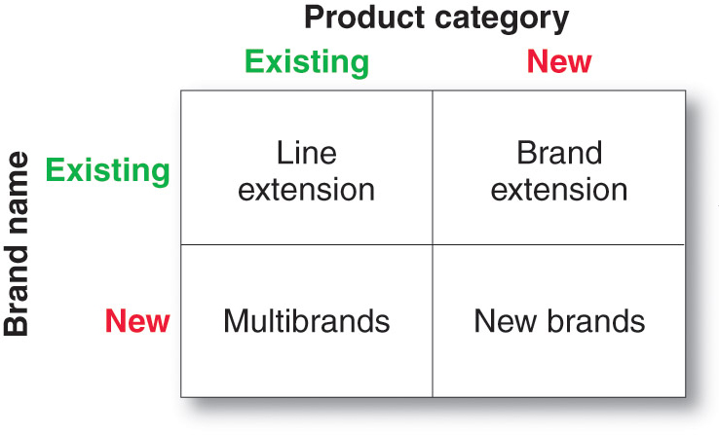
Branding Strategy: Building Strong Brands
D- Brand Development Strategies

Slide 38
Brand Strategy
Line Extension
  Existing brand names extended to new forms, sizes, and flavors of an existing product category. e.g , Bata
Brand Extension
  Existing brand names extended to new product categories.e.g Maggi noodles, Maggi ketchup, ponds
Multibrands
  New brand names introduced in the same product category. Surf ecxell, Rin, Sunlite
New Brands
  New brand names in new product categories.

Slide 39
Services Marketing
Types of Service Industries
Government
Private not-for-profit organizations
Business services

Slide 40
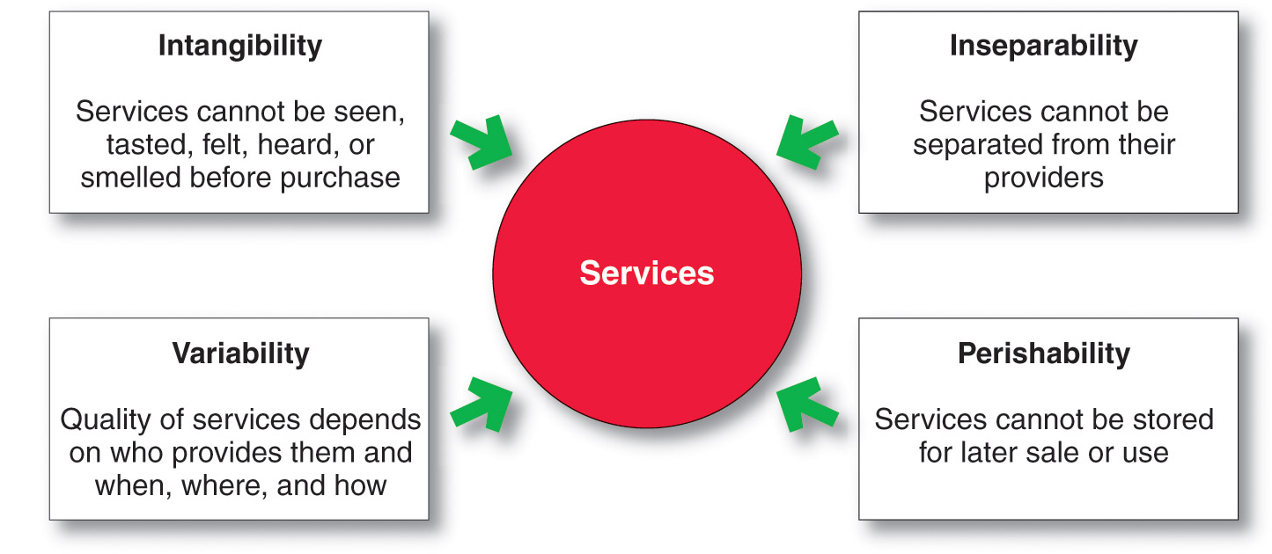
Services Marketing
Nature and Characteristics of a Service
Notes:
Note to Instructor
Intangibility refers to the fact that services cannot be seen, tasted, felt, heard, or smelled before they are purchased.
Inseparability refers to the fact that services cannot be separated from their providers.
Variability refers to the fact that service quality depends on who provides the services as well as when, where, and how they are provided.
Perishability refers to the fact that services cannot be stored for later sale or use.

Slide 41
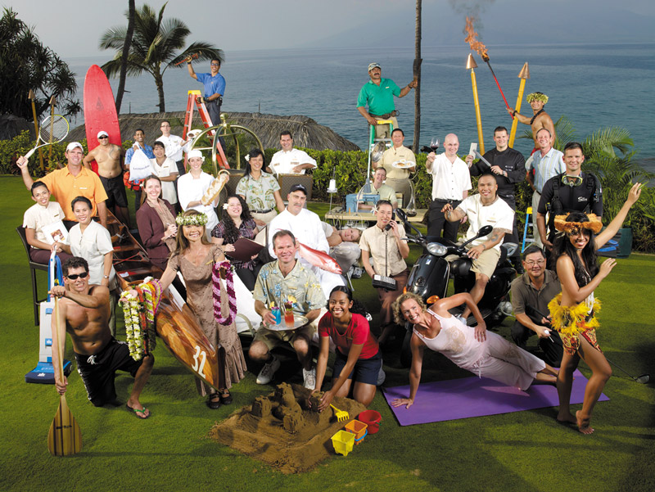
Services Marketing
Marketing Strategies for Service Firms
In addition to traditional marketing strategies, service firms often require additional strategies
Service-profit chain
Internal marketing
Interactive marketing

Slide 42
Services Marketing
Marketing Strategies for Service Firms
Service-profit chain links service firm profits with employee and customer satisfaction
Internal service quality
Satisfied and productive service employees
Greater service value
Satisfied and loyal customers
Healthy service profits and growth

Slide 43
Services Marketing
Marketing Strategies for Service Firms
Internal marketing means that the service firm must orient and motivate its customer contact employees and supporting service people to work as a team to provide customer satisfaction
Internal marketing must precede external marketing

Slide 44
Services Marketing
Marketing Strategies for Service Firms
Interactive marketing means that service quality depends heavily on the quality of the buyer-seller interaction during the service encounter
Service differentiation ( offer, delivery and image)
Service quality
Service productivity

Slide 45
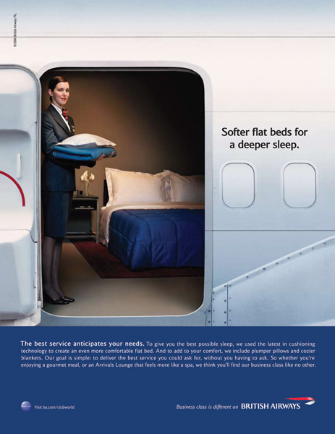
Services Marketing
Marketing Strategies for Service Firms
Managing service differentiation creates a competitive advantage from the offer, delivery, and image of the service
Offer can include distinctive features
Delivery can include more able and reliable customer contact people, environment, or process
Image can include symbols and branding

Slide 46
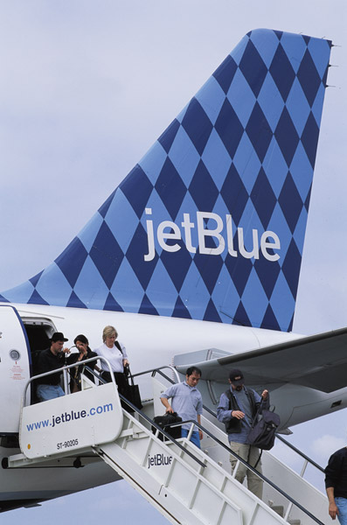
Services Marketing
Marketing Strategies for Service Firms
Managing service quality provides a competitive advantage by delivering consistently higher quality than its competitors
Service quality always varies depending on interactions between employees and customers
Notes:
Note to Instructor
Discussion Questions
Have you ever been disappointed in an airline? Did you fly that airline again?
Good service recovery can turn angry customers into loyal ones. In fact, good recovery can win more customer purchasing and loyalty than if things had gone well in the first place. Therefore, companies should take steps not only to provide good service every time but also to recover from service mistakes when they do occur

Slide 47
Services Marketing
Marketing Strategies for Service Firms
Managing service productivity refers to the cost side of marketing strategies for service firms
Employee recruiting, hiring, and training strategies
Service quantity and quality strategies

